Slide 1
Financial Modeling
Portfolio optimization
Jacqueline Garner, Ph.D.
Lecturer
Scheller College of Business
Review of statistics functions
Notes:
Hello, I’m Jacqueline Garner, and welcome to Financial Modeling

Slide 2
Before we begin slide
Notes:
In this lesson we will review some statistics functions, mean, variance, and std. deviation for populations and samples! We will also review covariance and correlation

Slide 3
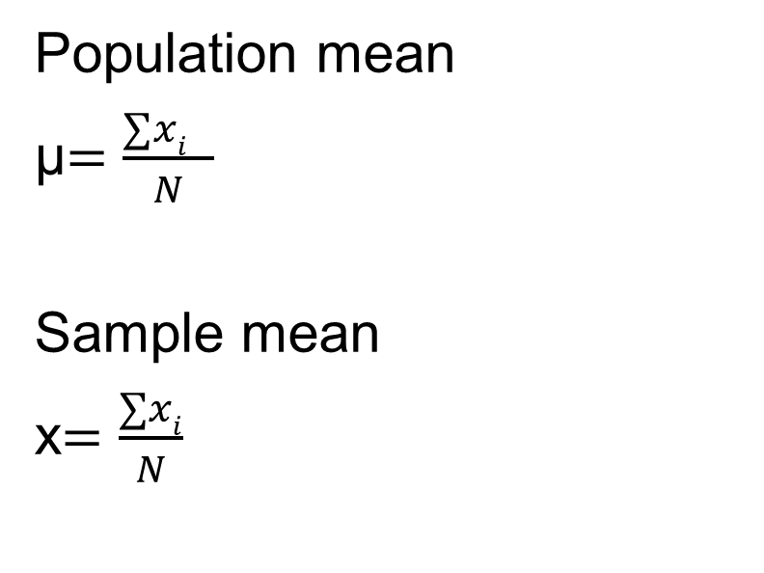
Mean of population vs. sample
Population mean
μ$=\frac{∑xi }{N}$
Sample mean
x$=\frac{∑xi}{N}$

Slide 4
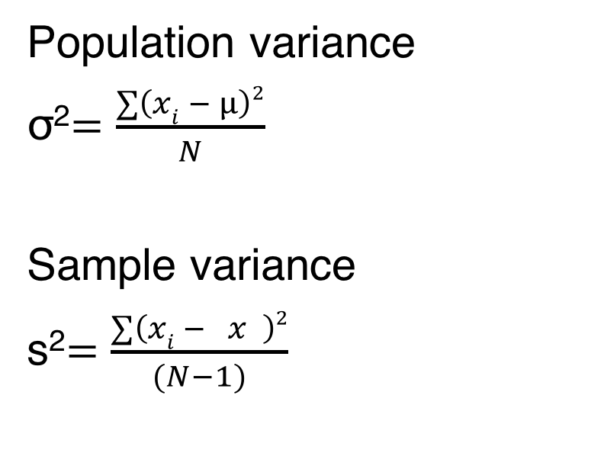
Mean of population vs. sample
Population variance
σ²$=\frac{∑\left(xi − μ\right)2}{N}$
Sample variance
s²$=\frac{∑\left(xi − x \right)2}{(N−1)}$

Slide 5
Standard deviation
Standard deviation is simply the square root of the variance
Population standard deviation = σ
Sample standard deviation = s

Slide 6
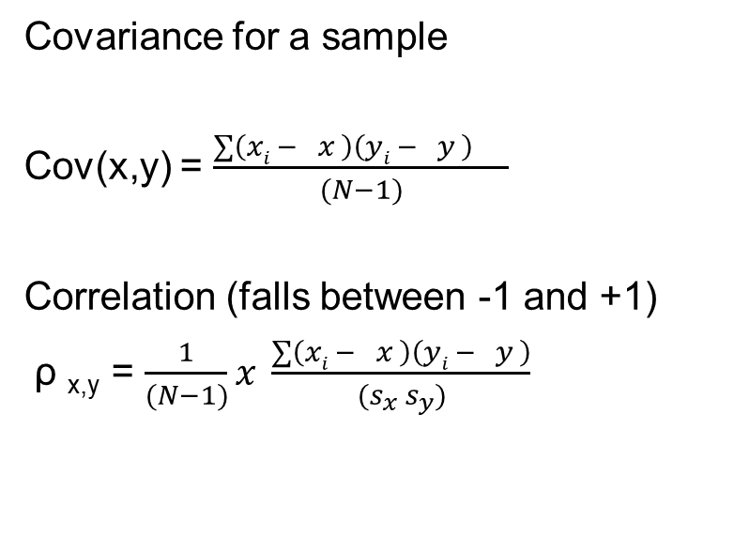
Covariance and correlation
Covariance for a sample
Cov(x,y) = $\frac{∑\left(xi − x \right)\left(yi − y \right) −− }{(N−1)}$
Correlation (falls between -1 and +1)
ρ _{x,y} = $\frac{1}{(N−1)}x \frac{∑\left(xi − x \right)\left(yi − y \right)}{(s_{x} s_{y})}$

Slide 7
Summary slide
Notes:
Thankyou!

